Slide 1
Predicting the Likelihood of Employee Attrition
Melvin Wong
Springboard Data Science Capstone Project

Slide 2

The Problem
According to Gallup report, a new employee takes around 12 months to become fully productive in their new role
What factors affect employee attrition?
Can we predict the likelihood of an employee leaving?

Slide 3



Who might care?
Corporations
Small, medium, and large businesses

Slide 4
Factors that Might Affect Attrition
Work-life balance
Relationship satisfaction
Performance rating
Job satisfaction
Environment satisfaction
Education level
Manager
Recent promotions
Data Source: https://www.kaggle.com/datasets/pavansubhasht/ibm-hr-analytics-attrition-dataset

Slide 5
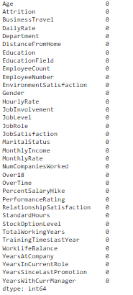
Data Wrangling
None the fields were null (luckily a clean dataset)

Slide 6
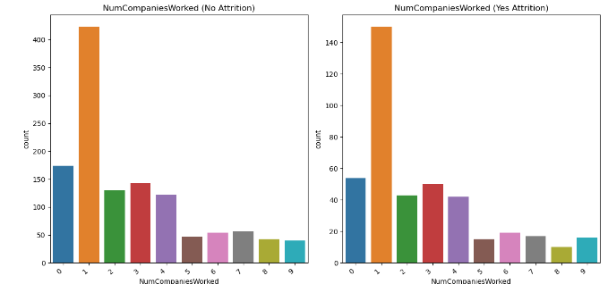
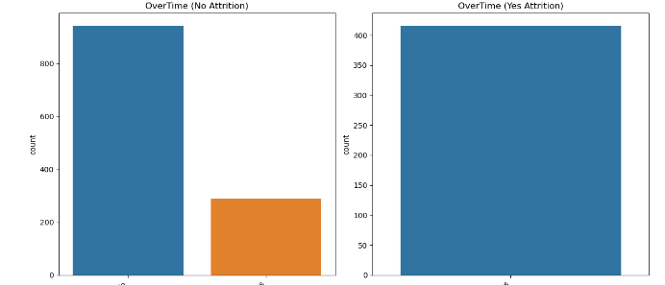
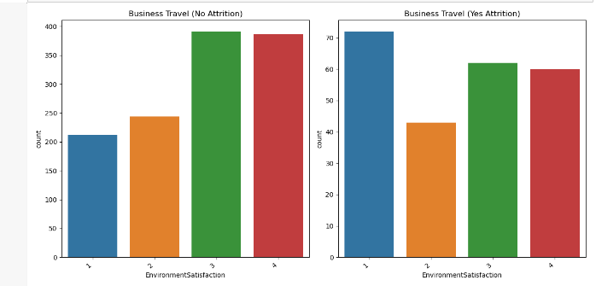
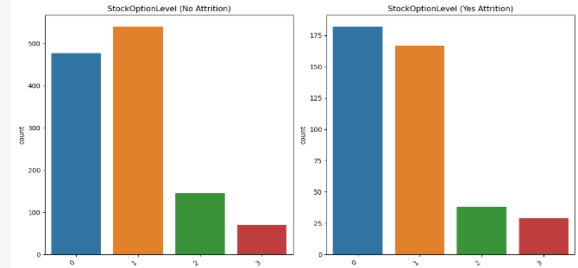
Exploratory Data Analysis
Generated graphs with attrition count with the different variables:

Slide 7
Machine Learning Modeling
Type: Supervised learning
Binary classification: 1 for “yes” to attrition and 0 for “no” to attrition
Tools: Python’s sci-kit learn and imblearn

Slide 8
Model steps
Data pre-processing steps:
Label encoding
Data splitting into training and test sets (70% - 30%)
Find models that accurately identify attrition
Find the features that are most relevant to attrition

Slide 9
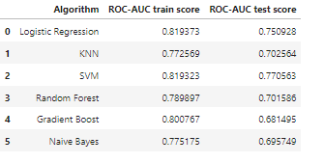
Results
Using the ROC-AUC train and test score, found that the logistic regression model best supported attrition

Slide 10
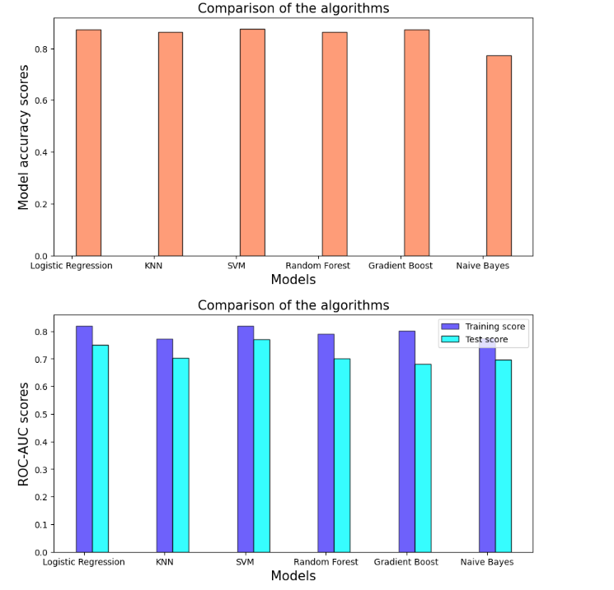
Additional graph support

Slide 11
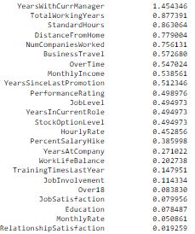
Most important features

Slide 12
Future Improvements
Get more data from varying company sizes
Not all companies are the same
Some other variables and factors could impact an employee’s decision to stay at the company such as mission statement, growth, and stock price,

